Slide 1



Frito Lay Attrition Analysis
Amber burnett
aburnett@smu.edu

Slide 2
SIGNIFICANT FINDINGS

Slide 3
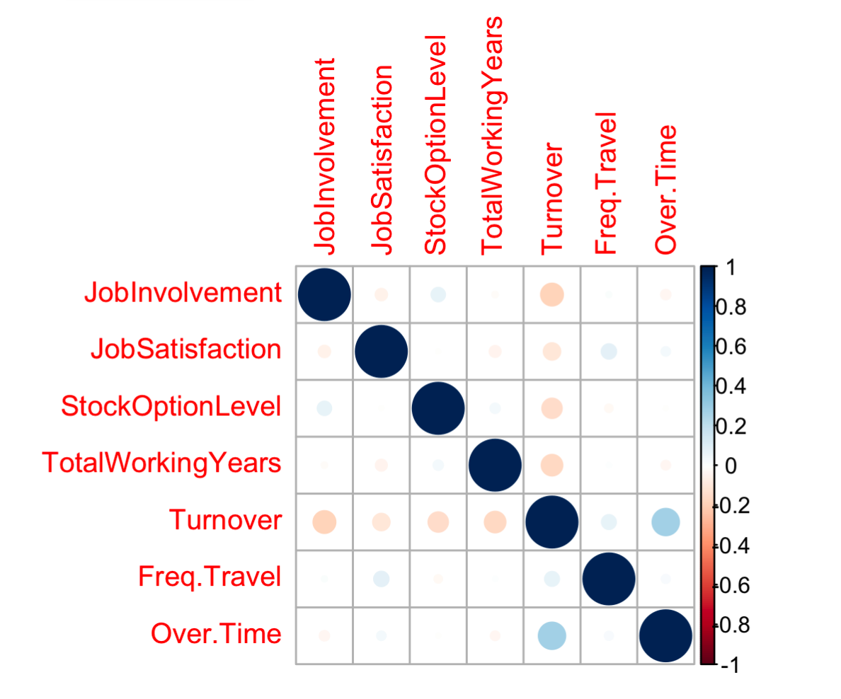
Factors That Correlate to Attrition

Slide 4
Key Factors/ Factor 1: Over Time

Slide 5
Key Factors/ Factor 2: Job Involvement

Slide 6
Key Factors/ Factor 3: Job Satisfaction

Slide 7

Applying powerful statistical methods
KNN Method
Logistic Regression
Linear Model

Slide 8
Recommendations to Lower Attrition
Strategy 1: Promote A Positive Work-Life Balance for Employees
Strategy 2: Increase Employee Engagement and Excitement
Strategy 3: Employees are Significant-Use the Methods and the Model

Slide 9
Your family, Your Employees, and Frito-Lay are All That and Yes a Bag of Chips!

